Slide 2

Introduction to Deep Learning
Neuron, Perceptron, Logistic, MLP, Rectified Linear Units
Backpropagation Algorithm, Mini-batch
2) Notebook – Regression
Tensor operations, NN layers and loss functions

Slide 3




Slide 4











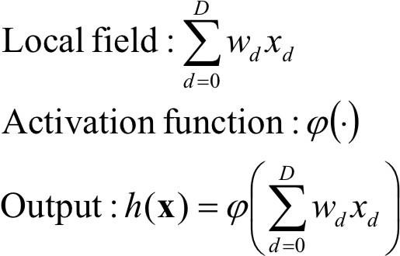
INPUT
Weights
OUTPUT
NEURON
ACTIVATION FUNCTION

Slide 5


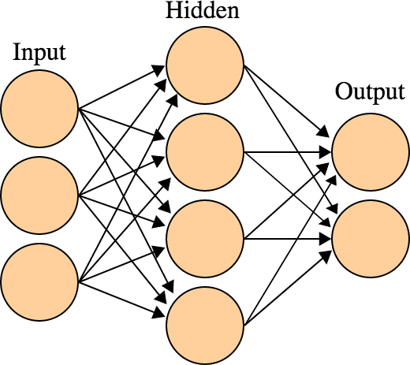
–Input layer of source
» The network is formed by
nodes
–One or several hidden
layers of processingneurons
–Output layer of processed
neurons
» Connections only between
adjacent layers
» There are no feedback
connections
source: https://en.wikipedia.org/wiki/Artificial_neural_network

Slide 7

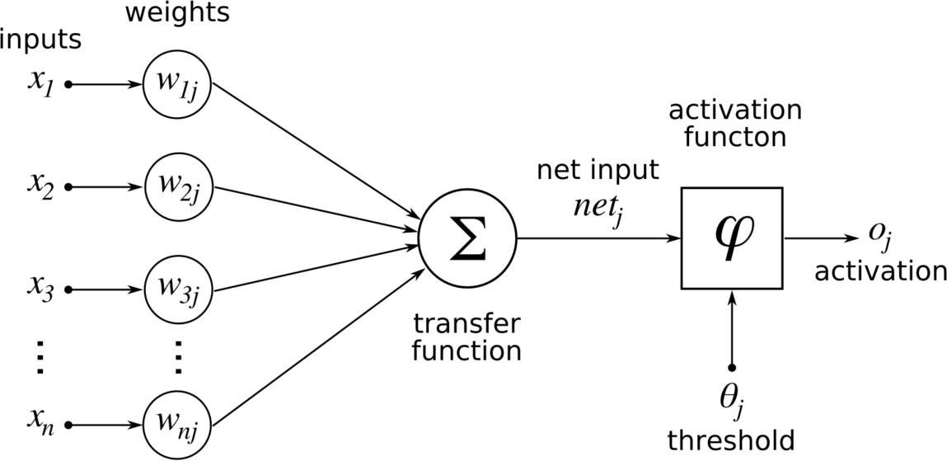
activation function of a node defines the output of that node given input(s)
source: https://en.wikibooks.org/wiki/Artificial_Neural_Networks/Activation_Functions

Slide 8


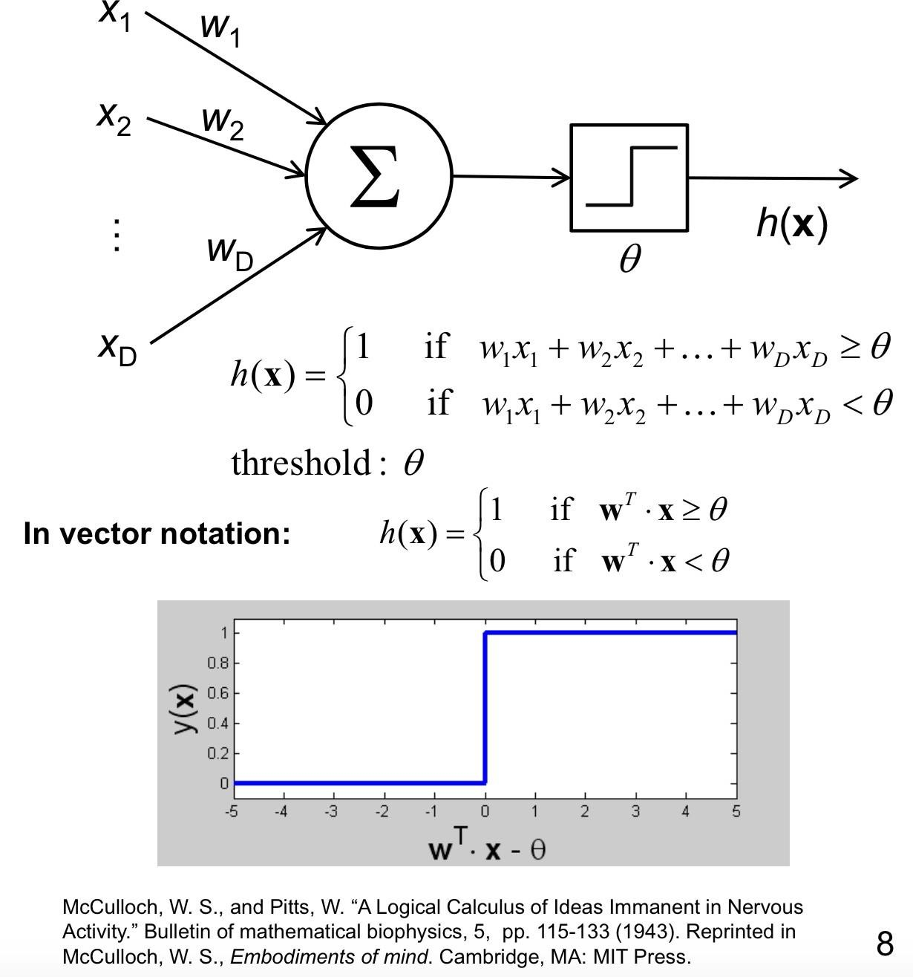
Invented in 1957.
Classifies input data into one of the
output classes.
If the weighted input is
more than the threshold, classify as 1.
Else 0
source: ASDM Summer School on Deep Learning 2014

Slide 9




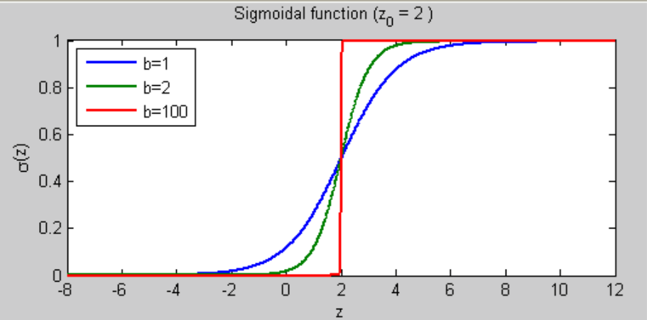
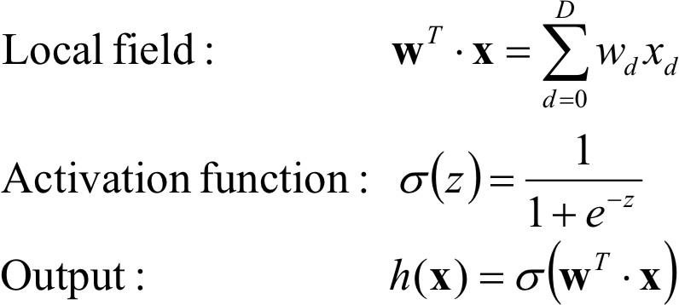
Output is bounded between 0:1
Domain: Complete set of
Real numbers
Smooth and continuousfunction.

Slide 10



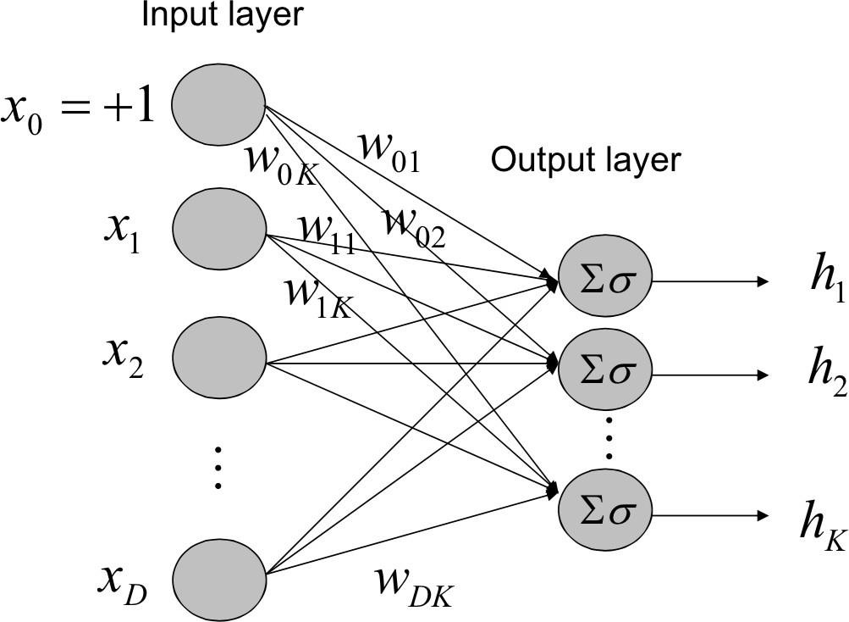
Generalization of logistic regression for Multi-class classification

Slide 11
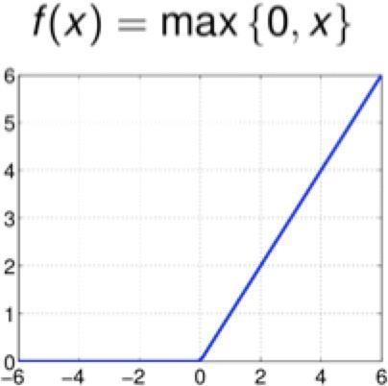
Cheap tocompute
Faster training
Sparser networks
Bounded below 0
Strictly increasing

Slide 12





Slide 13




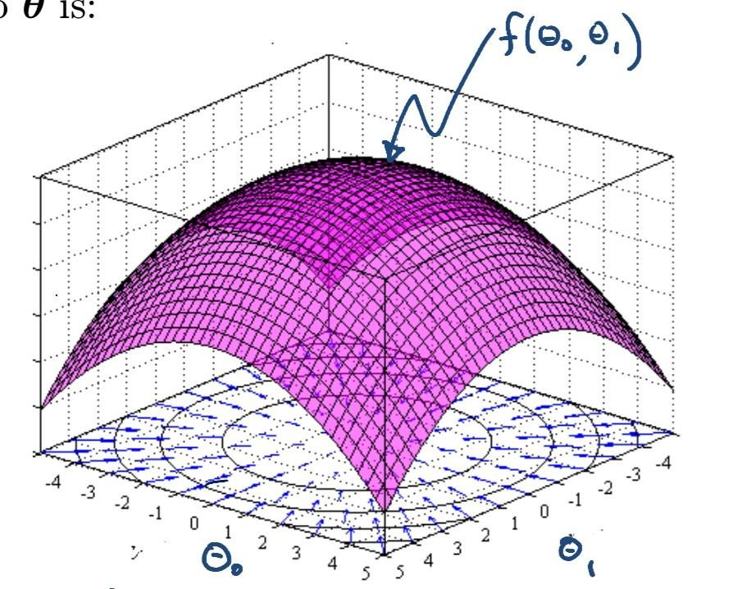
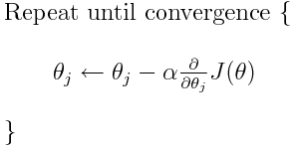
Goal: To find minimum of the loss function (minimize error of themodel)

Slide 14
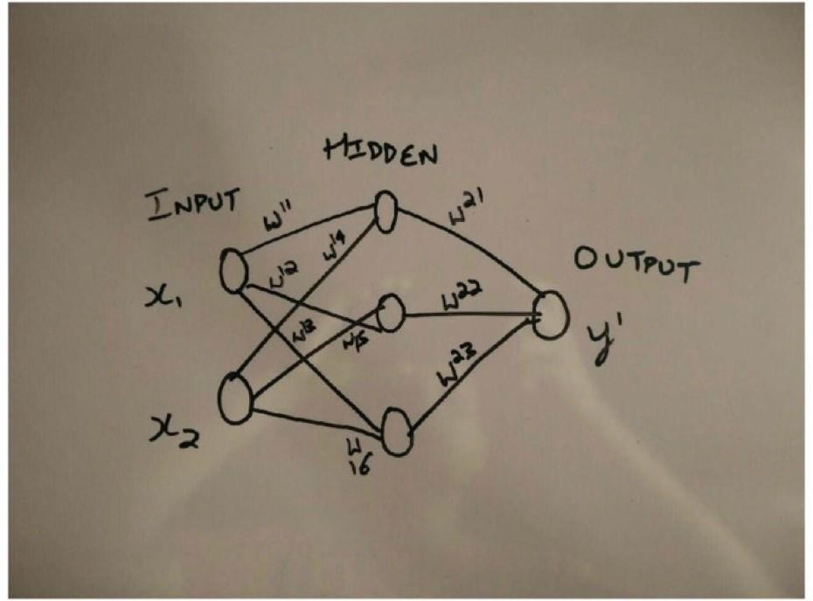

Slide 15
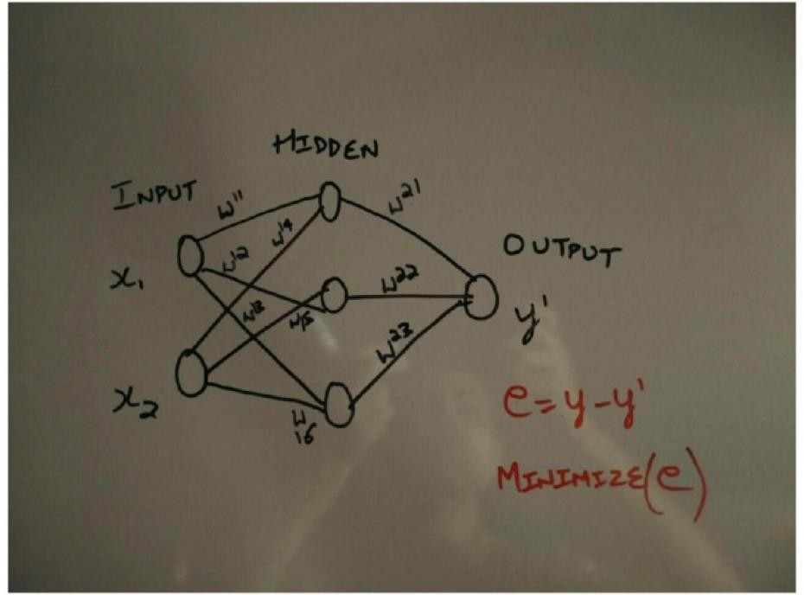
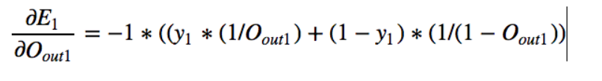


Slide 16
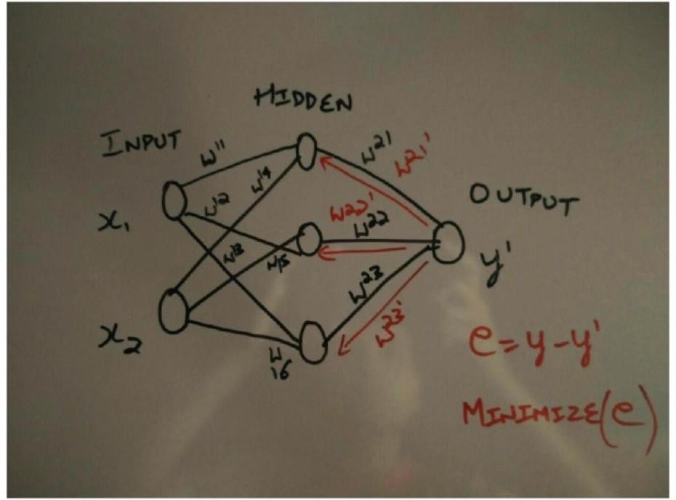
Derivative of cross entropy
Derivative of softmax wrt output layer input
Derivative of output layer input wrt weights
Error Derivative

Slide 17
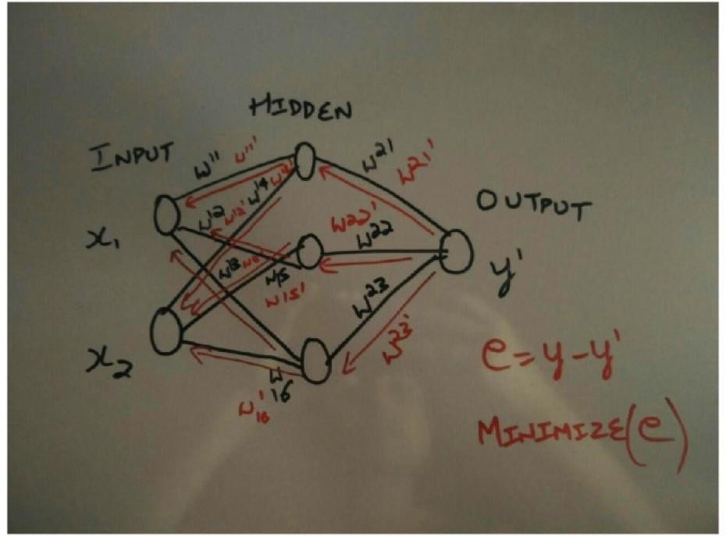
Derivative of hidden layer output wrt its input
Derivative of hidden layer input wrt weights
Error Derivative

Slide 18
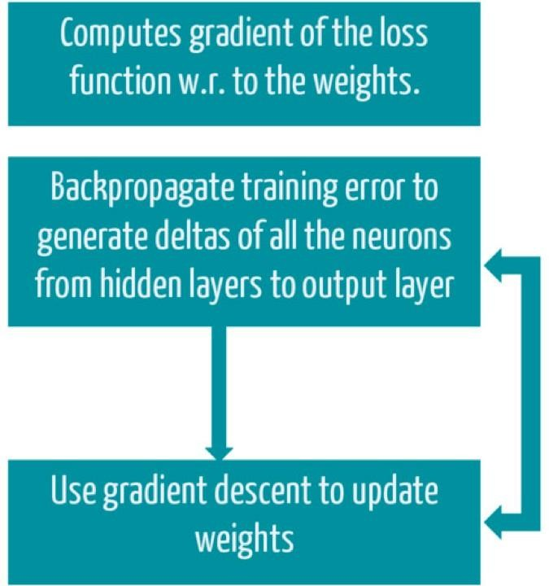

Slide 19




Stochastic Gradient Descent: Instead of using
all of the training data, train iteratively on “mini-
batches”
There are other variants of the loss function
– with better empirical results than SGD

Slide 20
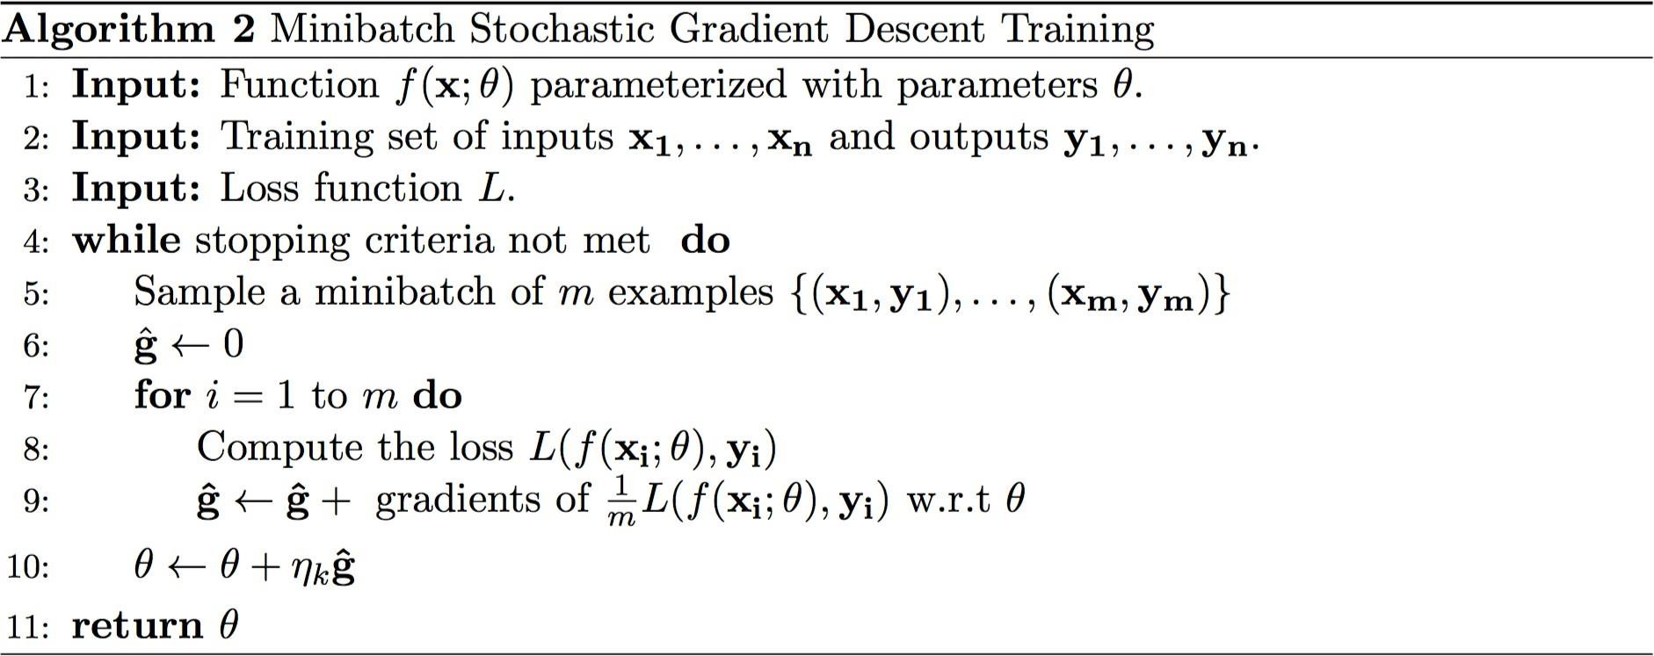
source: http://u.cs.biu.ac.il/~yogo/nnlp.pdf

Slide 21
Questions

